Slide 1
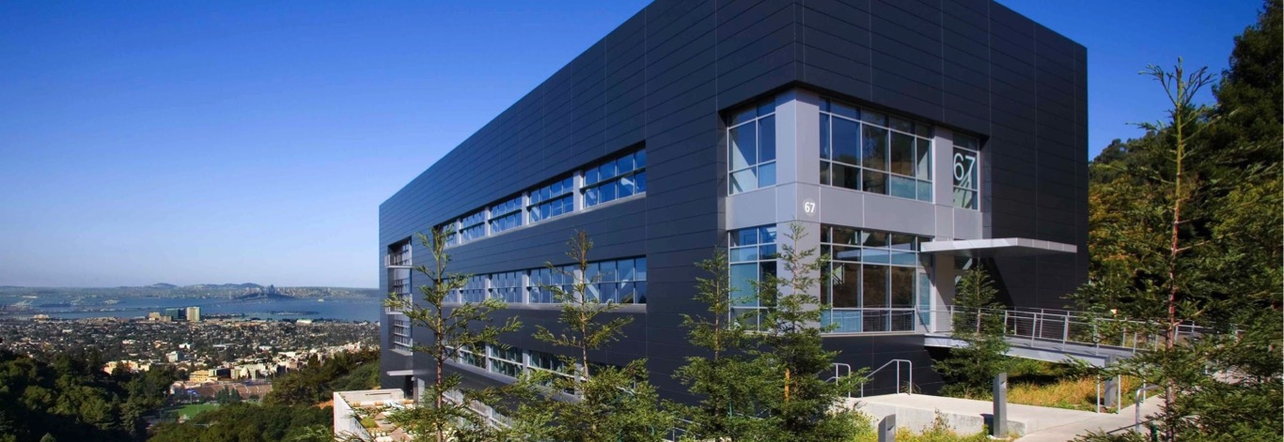


User Facilities at Berkeley Lab
Jeff Neaton
Molecular Foundry Director
Associate Laboratory Director for Energy Sciences
Lawrence Berkeley National Laboratory

Slide 2



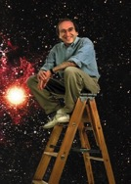


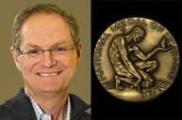
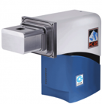





National Laboratory Mission & Context
Science solutions on national priorities
Discovery science
Advanced instrumentation & large user facilities
Managed, large research teams
Early career and postdoctoral scientists
Promising technologies with long, risky R&D paths
CMOS detector for
electron microscopy
100,000 frame/second
EM detector
Notes:
Science solutions on national priorities: Energy, Security, Economy, Environment, Health
16 Berkeley Lab scientists have been awarded the National Medal
Discovery science: Nobel-worthy discoveries like Perlmutter’s expanding universe and Calvin Cycle for photosynthesis
Advanced instr. & user facilities: Peter Denes direct electron detectors revolutionized electron microscopy: all our user facilities
Managed large teams: JBEI, EFRC Nanoscale Controls Geologic CO2
Core Capabilities: 22 including Accelerator and Computational Science, but also Subsurface Science (Fukushima)
Early career scientists: attracting top early-career scientists to areas of national need.
Technologies with long R&D paths: Biogenic materials, membranes for desalination, genomics, super windows, compact accelerators, quantum & other novel computing platforms
Gatan’s K2 is 16 megapixels, 400 frames/sec [optimized for cryoEM, where you want lots of pixels]
We are currently funded by BES to develop The 4D STEM is 1/3 megapixel, 100,000 frames/sec [optimized for scanning probe microscopy of materials, where you don't need that many pixels, but need speed]

Slide 3
The DOE National Laboratories
Notes:
17 national labs

Slide 4
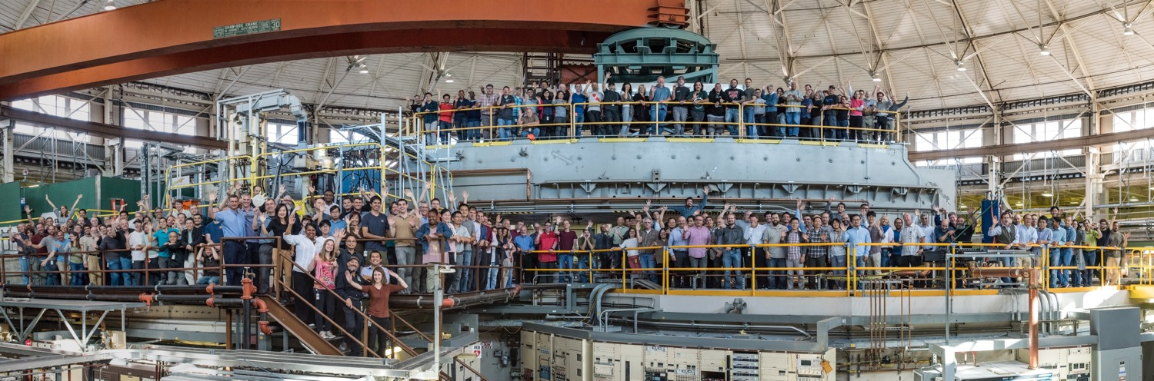
“The day when the scientist, no matter how devoted, may make significant progress alone and without material help is past. This fact is most self-evident in our work. Instead of an attic with a few test tubes, bits of wire and odds and ends, the attack on the atomic nucleus has required the development and construction of great instruments on an engineering scale.”
Ernest O. Lawrence

Slide 5

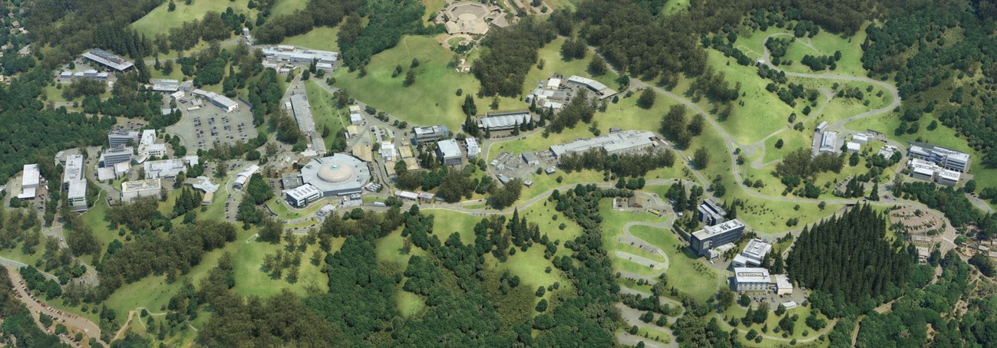




Berkeley Lab’s User Facilities
User facilities provide unique research resources to the scientific community in order to increase the scope, technical depth, and impact of their research.
Each year, Berkeley Lab serves ~11,500 members of the U.S. and international scientific community

Slide 6
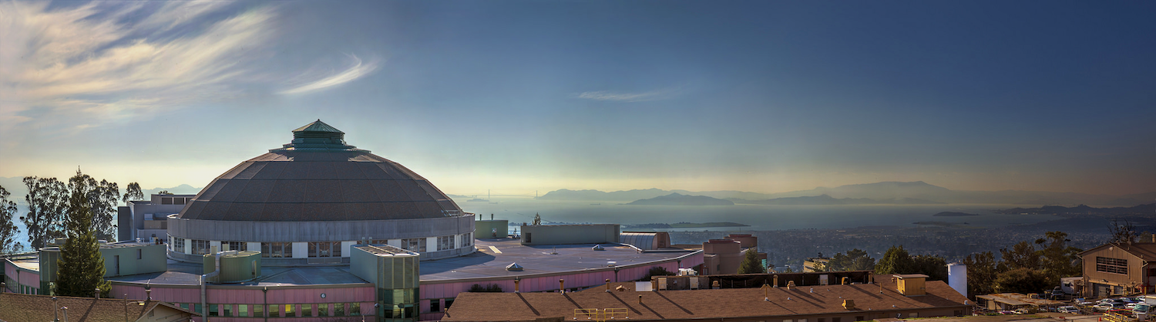
Advanced Light Source
  World-leading synchrotron light source facility for high-brightness soft x-ray science
  Additional leading-edge performance ranging from the infrared through hard x-ray spectral regions
Notes:
Soft x-rays – photons 10^2-10^3 eV; high brightness, 10^9 more bright than sun

Slide 7
The ALS: World Leading Soft X-Ray Facility for Scientific Discovery
Notes:
High-brightness x-rays from accelerated electrons are directed through about 40 beamlines to numerous experimental endstations, where scientists from around the world (“users”) can conduct research in a wide variety of fields, including materials science, biology, chemistry, physics, and the environmental sciences.
44 beamlines

Slide 8
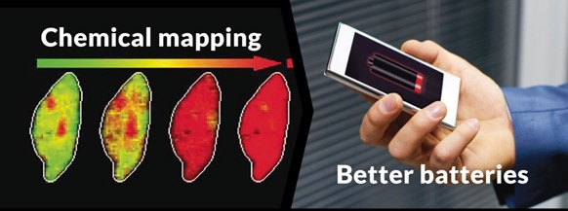
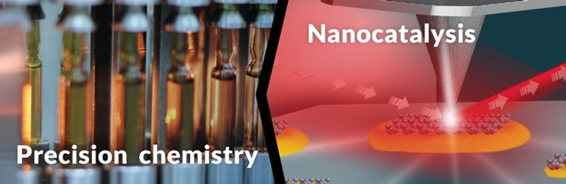
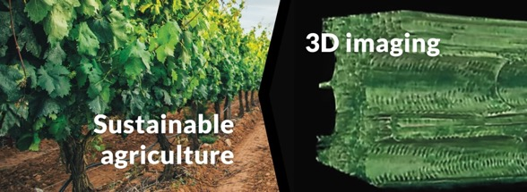

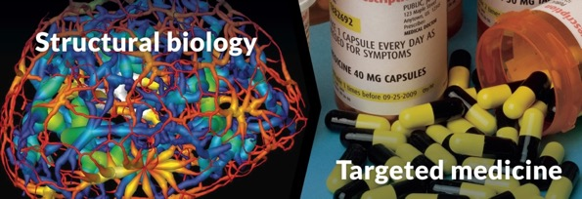
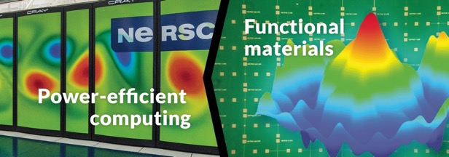
ALS Science & Example Capabilities
  scanning transmission x-ray microscopy
  synchrotron infrared nanospectroscopy
  x-ray microtomography
  angle-resolved photoemission spectroscopy
  protein crystallography; soft x-ray tomography
  scanning transmission x-ray microscopy;
  EUV lithography

Slide 9
ALS Scale and Scope
  2,000+ users and ~1,000 peer-reviewed journal articles each year
  40 beamlines, all operating simultaneously
  $65 million operating budget from DOE-BES
  180 staff (scientists, engineers, technicians, operations and support staff)
  5,000 hours of operation annually (run 24 hours/day when not in maintenance period)
  Average user stay is 1–3 days
Notes:
Mention peer review

Slide 10
Berkeley Lab’s User Facilities
User facilities provide unique research resources to the scientific community in order to increase the scope, technical depth, and impact of their research.
Each year, Berkeley Lab serves ~11,500 members of the U.S. and international scientific community

Slide 11
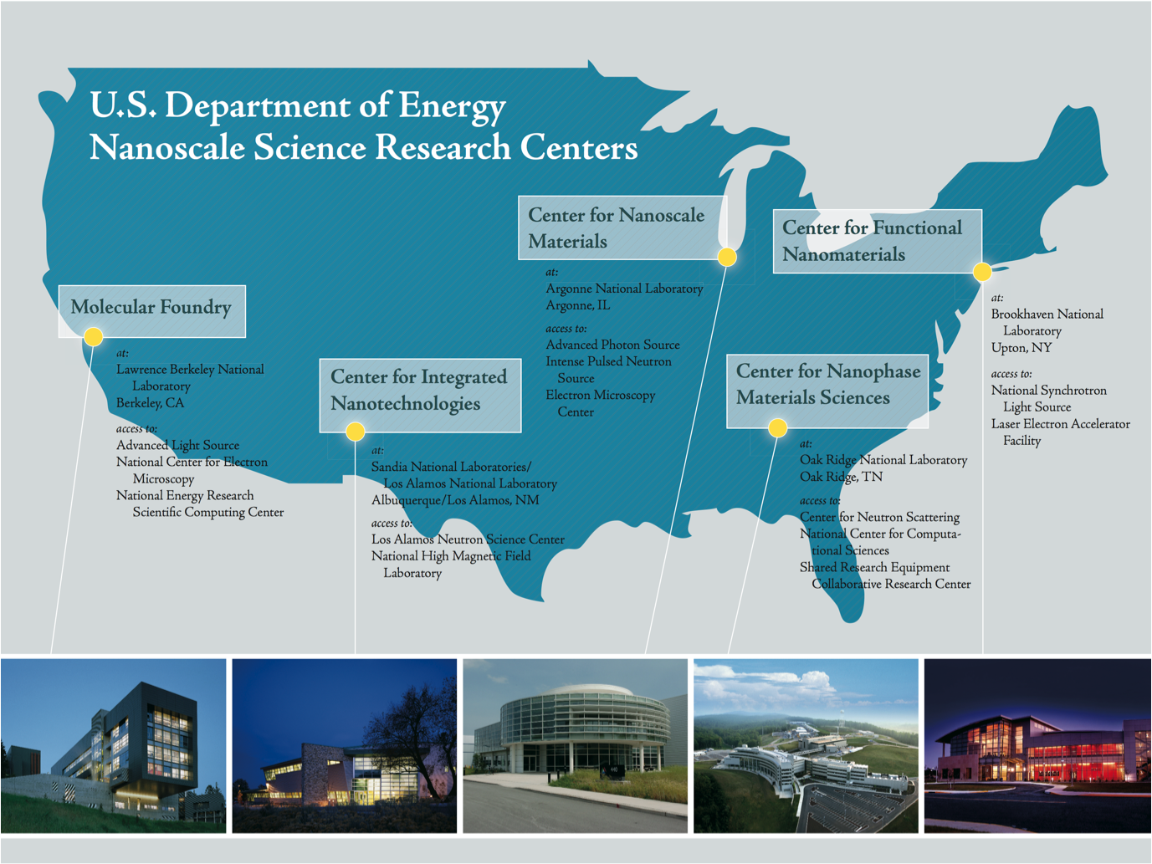
Notes:
one of 5 nanoscale science research centers nationwide

Slide 12
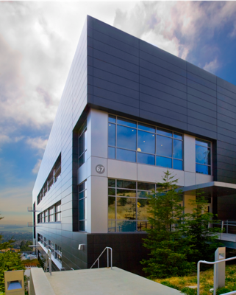
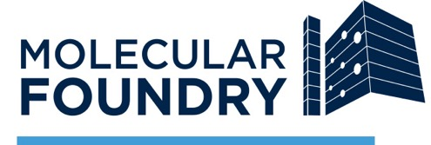
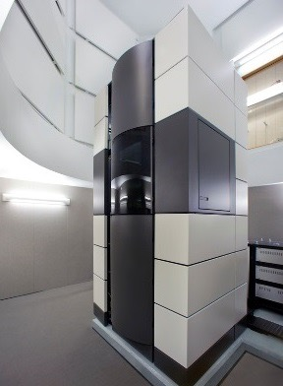
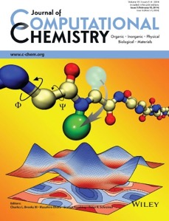
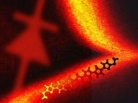
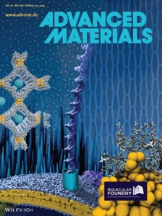
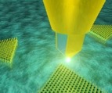
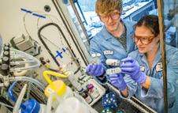
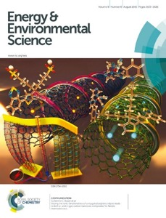
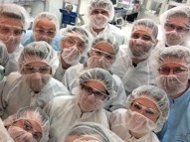
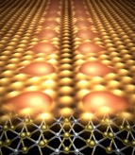
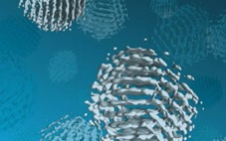
One of five Nanoscale Science Research Centers (NSRCs) funded by the U.S. Department of Energy
Knowledge-based user facility that provides state-of-the-art expertise, methods, and instrumentation in nanoscale science in a safe environment free of charge
Multidisciplinary research center at the forefront of nanoscale science
Notes:
-MF is a DOE national user facility for nanoscale science; science at scale
-Offers to users multidisciplinary staff expertise and state-of-the-art instrumentation in materials across a range of disciplines.
-Users access via a proposal review process.
-Inherently multidisciplinary frontier. Many projects at the leading edge are beyond the scope of one individual’s lab.

Slide 13
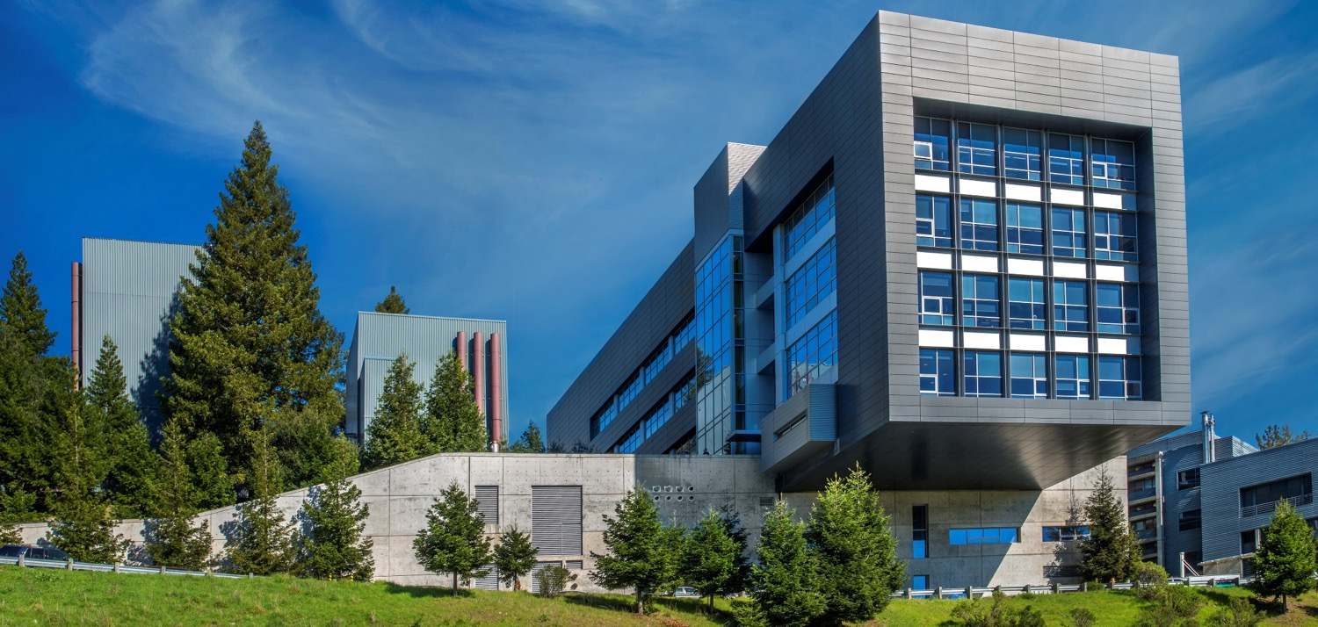
Characterization
Fabrication
Theory
Synthesis
NCEM
National Center for Electron Microscopy
Floor 1
Imaging and Manipulation of Nano-structures
Floor 2
Nano-fabrication
Floor 3
Theory of Nano-structured Materials
Floor 4
Inorganic Nano-structures
Floor 5
Biological Nano-structures
Floor 6
Organic and Macro-molecular Synthesis
Electron microscopy and nano-characterization
Characterization and manipulation of nanostructures
Advanced lithographic and thin-film processing techniques
Guiding understanding of new principles, behavior and experiments
Science of semiconductor, carbon and hybrid nanostructures
Bio-materials; new probes for bio-imaging; synthetic biology techniques
Soft materials: organics, macromolecules, polymers and their assemblies

Slide 14
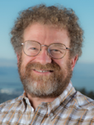
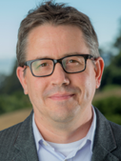
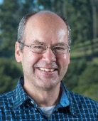
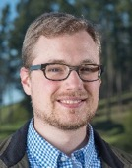
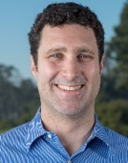
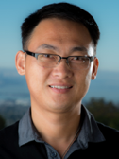
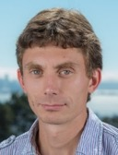
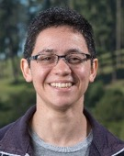
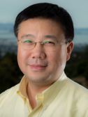
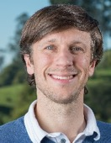
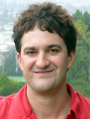
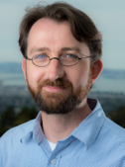
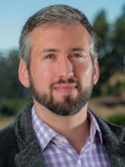

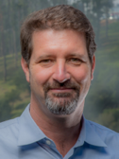
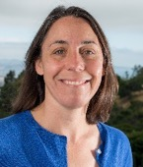
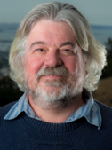
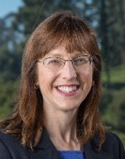
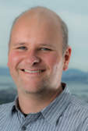
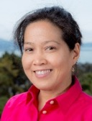
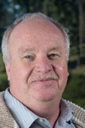
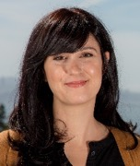
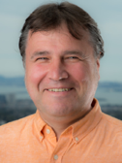
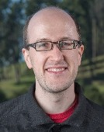
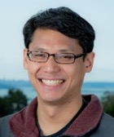

















Foundry Staff and Expertise
25 PI staff scientists on 50/50 model + 18 technical staff (plus 6 open recruitments)

Slide 15
50/50 Model at the Molecular Foundry
Scientific Staff (25)
  50% User research as determined by an external review panel
  50% internal research to maintain and develop expertise and capabilities accessible to users
  PI status
Technical Staff (18)
  Develop and maintain capabilities to support current and future user and staff research
  Non-PI status
Staff are 100% committed to the mission of the Foundry and 100% supported by the Foundry

Slide 16

“What most impressed you [users] about the Foundry?”

Slide 17























User and Staff High Impact Science
FY 2017
Budget: $28.2M
Publications: 355
Users: 866
Proposals: 617
P. Cao, et al, Adv. Mater. (2017)
Z. Niu, et al,
Nat. Mater. (2016)
N. Kornienko, et al, ACS Nano (2016)
D. Zhang, et al, J. Am. Chem. Soc. (2016)
N. Kornienko, et al, Proc. Natl. Acad. Sci. USA (2016)
H. Wang, et al, Angew. Chem. (2017)
B. Gao, et al, Nat. Chem. (2017)
A. R. Attar, et al, Science (2017)
L. Dou, et al, Proc. Natl. Acad. Sci. USA (2017)
S. Lee, et al, Science (2017)
A. Toor, et al, Nano Letters (2017)
Y. Yu, et al, Nano Letters (2016)
10 µm
W. Lee, et al, Proc. Natl. Acad. Sci. USA (2017)
K. Yao, et al, Phys. Rev. Lett. (2017)
Y. Su, et al, Nature Nanotech. (2016)
Y. Yu, et al, Nano Letters (2016)
M. Lai, et al, Nano Res. (2017)
T. Fukushima, et al, J. Am. Chem. Soc. (2017)
D. Lin et al, Sci. Rep. (2017)
Z. J. Wong, et al, Nature Photonics (2016)
Q. Yan, et al, Proc Natl Acad Sci U S A. (2017)
G. Calafiore, et al, Sci. Rep. (2017)
G. Calafiore, et al, Nanotechnology (2016)
A. Koshelev, et al, Opt Lett. (2016)
E.S. Barnard, et al, Adv. Mater., (2016)
Y. Yang, et al, Nature (2017)

Slide 18


















Unique Capabilities
Automated Synthesis Robots
X-ray spectroscopy theory and computation
Local Probes:
Camponile, AFM
SPLEEM + Skyrmions
V
e⁻
Li⁺
Li⁺
e⁻
Emory Chan Zuckermann
Schmid
Prendergast
Weber-Bargioni, Cabrini, Ashby
Hierarchial Theories of Self-Assembly
Electron Scattering & Detector Development
Joint SAXS-WAXS Beamline with ALS
Designer Molecules for Flexible Electronics
EUV Photoresists
Liu
Atomic Layer Deposition
Minor, Ophus, Ciston, Ercius, Denes,…
Ashby, Prendergast, Liu
Elaine Chan
Whitelam, Zuckermann
Synthesis of new low-d chalcogenides
Electron Tomography
3D Mapping of Subsurface Carrier Lifetimes
Schwartzberg
Hohman
Ercius, Ren
Barnard

Slide 19
Excellent Productivity, with Publications
Driven by Users and Collaborations
355
355
326
290
265
High Impact: 37% 39% 41% 36% 33%
Internal
(may have user co-authors)
User
(with Foundry co-authors)
User
(no Foundry co-authors)
Notes:
Most of our publications are driven by users and collaborations
Pubs are up 20% since 2013
Large fraction of pubs involve both staff and users, illustrating the NSRC collaborative model at work. Users are strongly benefiting from collaborations.
User only pubs are often from experienced follow-on users.
Is there a particular instrument or capability that dominates the 43% user-only work?

Slide 20
Foundry: Serving More Users Than Ever Before
866
774
Foundry
NCEM
677
~620
FY 2010 FY 2011 FY 2012 FY 2013 FY 2014 FY 2015 FY2016 FY2017
On average, each staff person is handling ~19 users
Each user spends about 3 months at the Foundry
Notes:
-We are serving more users than ever before
-Trends up to 2014 show NCEM+Foundry
-In FY14, the number is 422+205=627, including double counting (so this is a high estimate); In FY15, 677 unique users. On pace to beat 677 in FY16.
-But one can expect only so much growth in these numbers, given finite staff and instrument time.
-Staff time is #1 limiting factor in ability to increase number of users.
-Growth but saturation in the number of users up to 2014.

Slide 21







Diverse and Distinguished User Community
    In FY 2013-2015, proposals were submitted from:
    255 institutions
    40 states
    35 countries
    11% from industry
      10 Fortune 500 companies
    2 Nobel Laureates
    29 NAS/NAE members
    22 DOE Early Career Awardees
Notes:
On pace to improve on these numbers during our current review period

Slide 22



Geographically diverse proposal submissions
PI affiliation city on proposals submitted to MF FY13-FY15
1 proposal
5 proposals
10 proposals
20 proposals
30 proposals
500 proposals
Davis
Berkeley
San Francisco
Livermore
Stanford
San Jose
Merced
60% of proposals from extended Bay Area (~100 institutions)
Santa Cruz
Notes:
bay area: 956 of 1521 total (1285 US + 236 world)
=

Slide 23

Geographically diverse proposal submissions
PI affiliation city on proposals submitted to MF FY13-FY15
1 proposal
5 proposals
10 proposals
20 proposals
30 proposals
500 proposals

Slide 24
User Program Overview
Two calls per year for standard proposals
~2 page proposals, online form
Maximum project duration per proposal: one year
Free for non-proprietary research, intended for publication
Proposal Review Board: Reviews on site via a NSF/NIH-style external peer-review panel
Notes:
68 PRB members, typically 45 attend

Slide 25
What makes a good proposal?
Scientific/technological merit (30 pts)
Likely to advance the scientific or technological field
Likely to produce impactful publications
Project plan (10 pts)
Achievable in one year
Contributes to ongoing research at the user’s home institution
Need for the Foundry (10 pts)
Requested resources justified
Takes advantage of unique Foundry capabilities and expertise
Relevant experience (10 pts)
Reasonable impact on Foundry resources
Good track record for productive research

Slide 26
User projects vary widely in scope and duration
Long term, fully integrated user
- 1 yr project duration
- Users onsite at Foundry full-time
- Using multiple facilities
- Attending group meetings
- May have lab duties
Average user visit
~3 months
Current snapshot:
400 active proposals
200 pending proposals
~150 users onsite each day
range of scope & duration
Short term, targeted project
- Users onsite for 2-4 weeks
- Typically return users, already trained

Slide 27
Ongoing Issues
Recapitalization
  Foundry invests ~$2.7M/year (10% operating) for capital equipment
  Partner with other DOE programs, industry: in-situ TEM, Magic Leap/e-beam writer
Internal Science: Theme Capability Development Program
  Multi-facility collaborative projects supported by three postdocs for two years that aim to develop new Foundry capabilities
  Conformal 2d materials, new EM imaging techniques, reconfigurable halide perovskite materials, high-throughput synthesis and imaging…
Engaging Industry
  Metrics of success, publication culture, partnerships
Recruiting & Retaining Users & Staff
  Foundry director opening!
  Outreach: Staff talks at conferences, scientific symposia, special issues
  Mentoring: Novel career path with an emphasis on collaboration/shared resources

Slide 28

A Multidisciplinary Knowledge-Based User Facility for Nanoscale Science
Next User Mtg
August 15-16, 2018
Next call deadline
March 31, 2018

Slide 29






DOE Light Source User Facilities
APS (1996), 7 GeV
hard x-rays
ALS (1993), 2 GeV
soft x-rays
NSLS II (2016), 3 GeV
SSRL (1974, 2004), 3 GeV
LCLS (2009)

Slide 30


University–National Labs–Industry Nexus
Connection to market, national needs
Pragmatic R&D
PI- and peer-driven research on a project-by-project basis
Diverse funding environment
Most abstract research
Universities
Industry
National Labs
Team science
Facilities and projects of scale
Interdisciplinary integrator for long term, mission-driven research
Notes:
Talking point: the unique role of the labs as a conduit for energy R&D

Slide 31







Berkeley Lab: Open, Integrated, Sharing
Most productive integration with a
Each year, Berkeley Lab serves ~11,500 members of the U.S. and international scientific community
major research university
232
486
JOINT FACULTY
POST DOCS
263
148
GRAD STUDENTS
UNDERGRADS
FY2016
Public service has been part of our DNA for more than 80 years

Slide 32

Geographic Distribution of ALS Users in the U.S.
  Distribution of ALS user zip codes, FY15–17
  + International users from ~40 countries

Slide 33

ALS Data Management Policy
  From the ALS website:

Slide 34

Collaborations that Bring New Capabilities
  The Howard Hughes Medical Institute funded the construction of two protein crystallography beamlines at the ALS, which were commissioned in 2003.
  HHMI researchers get 75% of available beam time. The remaining 25% is open to general users.

Slide 35


Process for peer-review of user proposals
Onsite review meetings
Normalized scoring
More constructive feedback for users
40% faster
Lower burden on staff
Community building & outreach
48% regional
10% other CA
42% from outside CA
—
9% LBNL/UCB
10% Other Nat. Lab
64% University
17% Industry
Bio Facility Proposal Review Board, spring 2014
Imaging Facility Proposal Review Board, spring 2014

Slide 36
Local partnerships - Haimei

Slide 37
Majority of proposals are multi-facility
Number of facilities requested on accepted proposals, FY13-FY15 (1057 total)
3 or more
27%
1 facility
48%
2 facilities
25%

Slide 38
Impact

Slide 39



Theme Capabilities Development Program
    Multimodal Nanoscale Imaging
    Direct Structural Determination of Soft & Hybrid Nanostructures with a Structured Phase Electron Beam (MIDI-STEM)
  Peter Ercius, Colin Ophus (NCEM); Caroline Ajo-Franklin (Bio); Jeff Urban (Inorganic)
    Functional Nanointerfaces
    Wide-Area and Conformal Transition Metal Dichalcogenide Heterojunctions
    Alex Weber-Bargioni (Imaging); Adam Schwartzberg (Nanofab);
    Shaul Aloni (Imaging, Inorganic); Eli Rotenberg, Mike Brady (ALS)
    Combinatorial Nanoscience
    A Combinatorial Approach to Multifunctional Porous Graphitic Materials (PGMs)
    Jim Ciston (NCEM), Yi Liu (Organic), Jeff Urban, Emory Chan (Inorganic), Steve Whitelam (Theory), Mike Brady (ALS)
    Single-Digit Nanofabrication and Assembly
    Quantum-Confining Metal-Organic Chalcogenide Assemblies (MOCHAs) for Energy Transport and Photonics
    Nate Hohman, Tev Kuykendall (Inorganic), Adam Schwartzberg (Nanofab), Jim Schuck (Imaging)
C. Ophus, et al. Nat Commun. 2016
S. Barja, et al. Nature Phys. 2016
Notes:
Program to foster multidisciplinary science toward the development of new capabilities for next-generation users
Each year, scientists are encouraged to form teams that cut across three or more scientific facilities and compete for resources to execute on these projects. These teams will be reporting out on progress at the end of the day’s program, just before the poster session. Stay tuned.

Slide 40





New TCDP Investments
    Functional Nanointerfaces
    Harnessing Responsive and Reconfigurable Organic-Inorganic Nanointerfaces for the Synthesis of Metastable Quantum Materials and Systems
    Brett Helms, Teresa Williams (Organic), Alex Weber-Bargioni (Imaging), David Prendergast (Theory)
    Multimodal Nanoscale Imaging
    Coherent Single-Electron Source for Quantum Microscopy and Spectroscopy
    Andreas Schmid, Colin Ophus (NCEM), Shaul Aloni (Inorganic), Stefano Cabrini, Adam Schwartzberg (Nanofab), Frank Ogletree, Alex Weber-Bargioni (Imaging), Howard Padmore (ALS)
p-GaN pillar
monochromatic electron beam
InGaN quantum dot
Notes:
Program to foster multidisciplinary science toward the development of new capabilities for next-generation users
Each year, scientists are encouraged to form teams that cut across three or more scientific facilities and compete for resources to execute on these projects. These teams will be reporting out on progress at the end of the day’s program, just before the poster session. Stay tuned.

Slide 41





Berkeley Lab User Facilities
Enabling breakthroughs across the sciences
FY2016
2,317 Users
1,391 Users
6,915 Users
The Advanced Light Source
The Joint Genome Institute
NERSC
528 Petabytes/yr.
774 Users
Energy Sciences Network
The Molecular Foundry
Notes:
Our user facilities have great impact on the national research enterprise, and we make sure they stay at the scientific frontier.
The Advanced Light Source (ALS) provides users with the bright x-ray beams they need to do cutting edge research in chemistry and materials.
The Joint Genome Institute (JGI) provides unique genomic tools and expertise to scientists advancing DOE science.
The NERSC facility provides world-class HPC to the broad DOE science community.
The Molecular Foundry connects its many users with state-of-the-art instrumentation and expertise in nanoscience.
ESNet connects massive data sets with HPC computing as we enter the exascale era.
The close links among these facilities are central to the scientific impact of Berkeley Lab.

